Slide 1
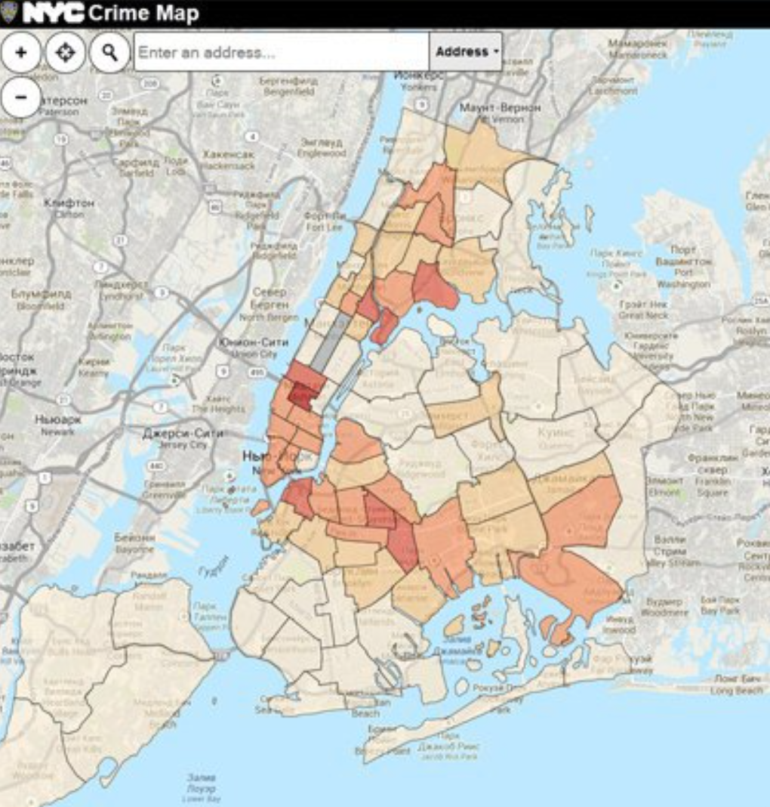
Analysis of NYPD Shooting Incident Data (Historic)
Data Source: The dataset is sourced from NYC OpenData, covering shooting incidents from 2006 to 2023, including variables such as borough, date/time, and outcome of the incidents, with 28,562 records.
Key Variables: Borough, Date/Time of Incident, Outcome.
Data Quality:
Comprehensive coverage across all NYC boroughs.
High completion rate in key fields; some variables have missing data.

Slide 2
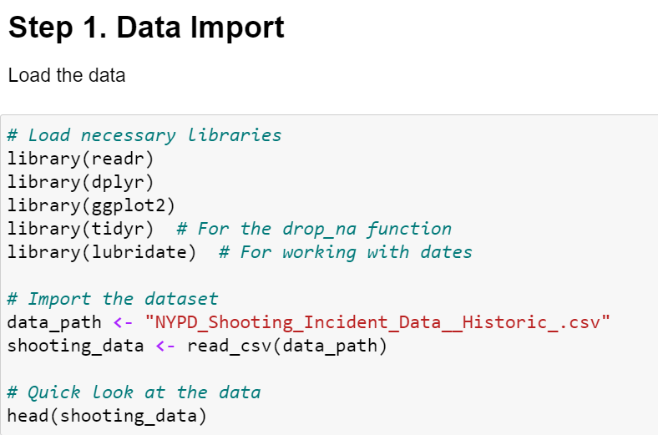
Data Import Process
Objective: Begin the analysis by loading the NYPD Shooting Incident Data (Historic).
Methodology:
Libraries Used: Utilized key R libraries for data manipulation and visualization including `dplyr` for data processing, `ggplot2` for plotting, `tidyr` for data cleaning, and `lubridate` for handling date-time data.
Data Loading: The dataset is loaded into R using `readr`'s `read_csv` function, ensuring efficient and straightforward CSV file parsing.
Initial Data Review: Quick examination of the dataset using `head()` function to ensure data integrity and correct loading.

Slide 3
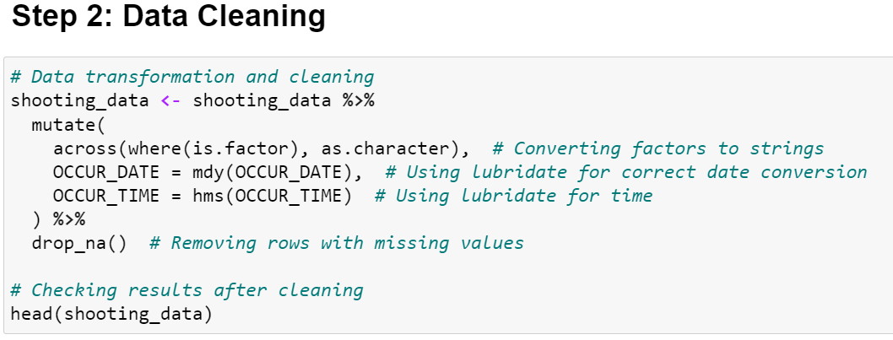
Preparing the Data for Analysis
Process Overview:
- Data Conversion: Factors converted to strings and dates and times standardized using `lubridate` for consistency.
- Removing Missing Values: Dropped rows with incomplete data to maintain the integrity of the analysis.
- Initial Check: Used `head()` to verify the dataset after cleaning.
Insights:
- Ensuring clean and well-structured data is essential for accurate analysis and modeling.

Slide 4
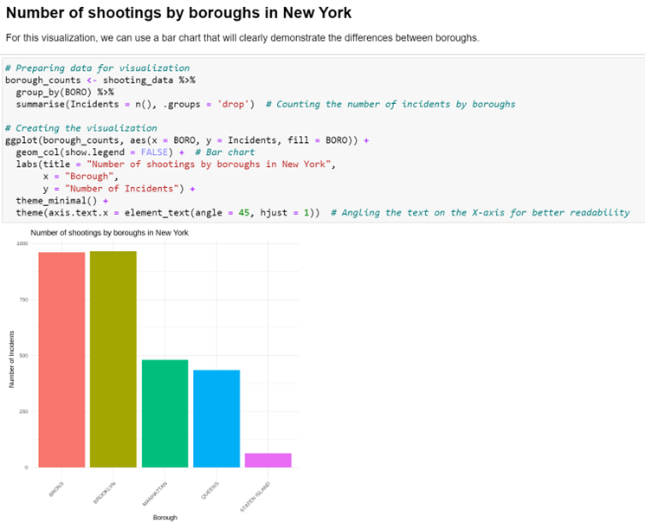
Exploratory Data Analysis (EDA)
Understanding Incident Distribution:
- Focus of Analysis: This step delves into the spatial and temporal distribution of shooting incidents.
- Spatial Distribution: We assess how incidents are spread across different boroughs of New York City.
- Temporal Trends: Analysis extends to understanding patterns over time including years, months, and days of the week.
Visualization Insight:
- Bar Chart Overview: The bar chart illustrates the number of shooting incidents across five boroughs. It reveals higher frequencies in certain boroughs, indicating potential areas of focus for law enforcement and policy makers.

Slide 5
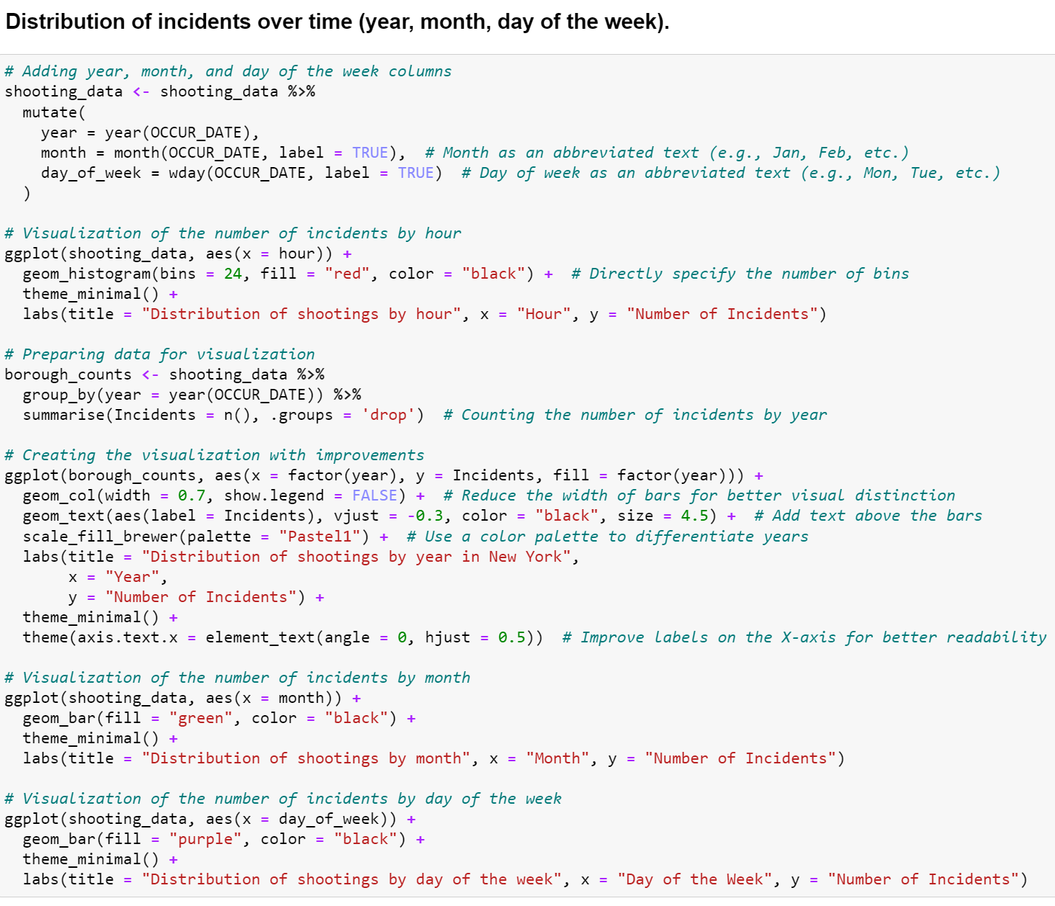
Temporal Analysis of Shooting Incidents
Overview of Temporal Distribution: Enhanced the dataset by adding time variables (year, month, day of the week) to uncover patterns. Visualizations highlight peak times and trends, aiding in strategic planning for law enforcement.
Key Visual Insights: Utilized `ggplot2` for creating distinct visualizations for each time segment, revealing seasonal variations and weekly patterns that help pinpoint critical periods for focused policing efforts.

Slide 6
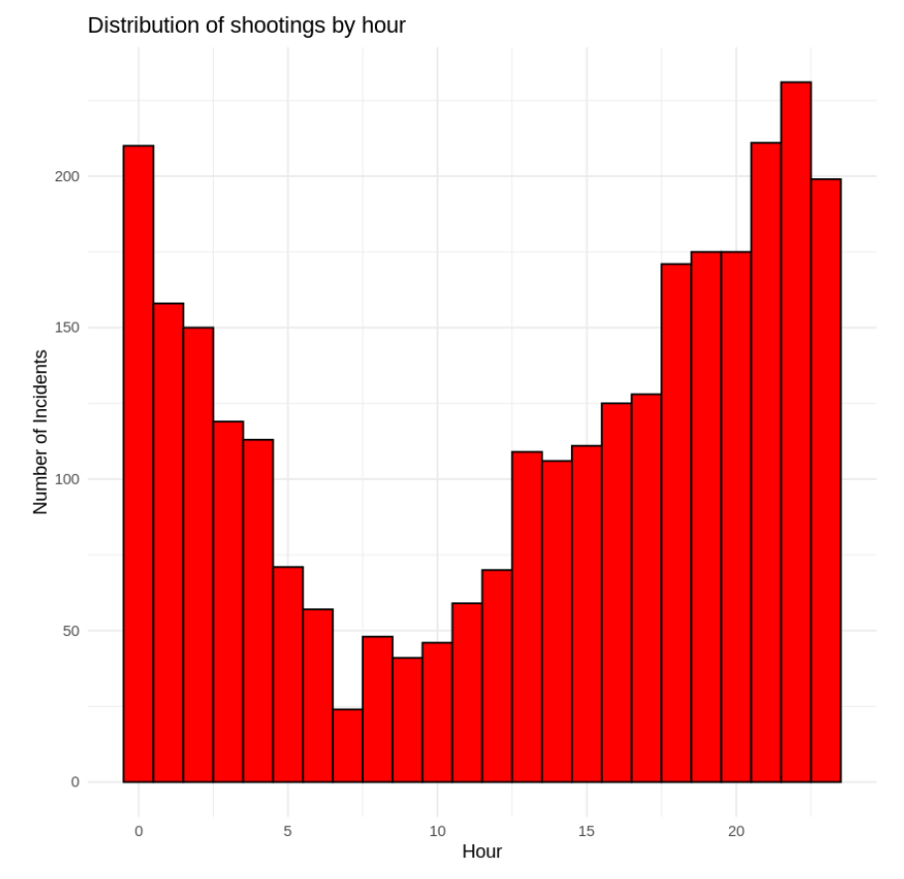
Hourly Distribution of Shootings
Here's a concise slide text that provides an analysis based on the hourly distribution of shootings, as depicted in the histogram:
- Pattern Analysis: The histogram shows a significant increase in shootings during early evening hours, peaking around midnight. A notable decrease occurs during early morning hours, suggesting lower activity between 3 AM and 9 AM.
- Implications: This pattern indicates that strategic policing and community interventions might be most needed in the late evening to early night hours to effectively reduce shooting incidents.

Slide 7
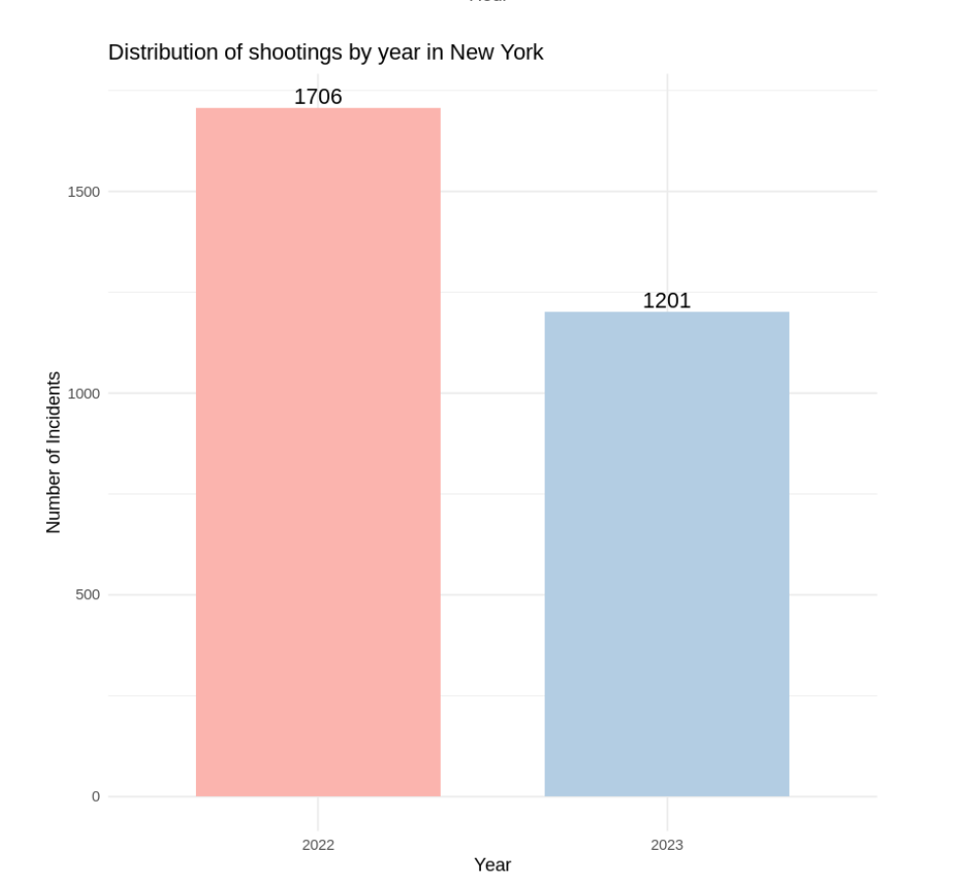
Incident Trends Over Time
Graph: Line graph displaying shooting incidents over time (yearly).

Slide 8
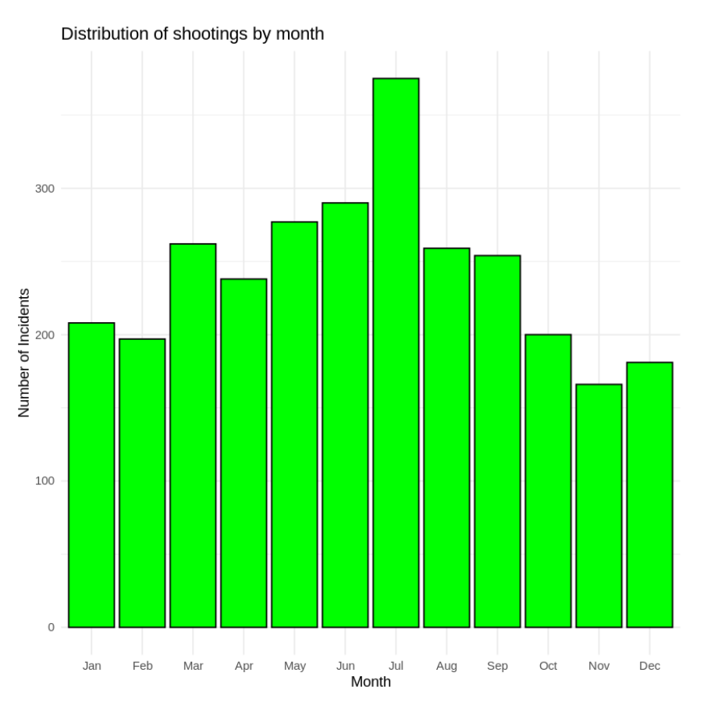
Incident Trends Over Time
Graph: Line graph displaying shooting incidents over time (months).

Slide 9
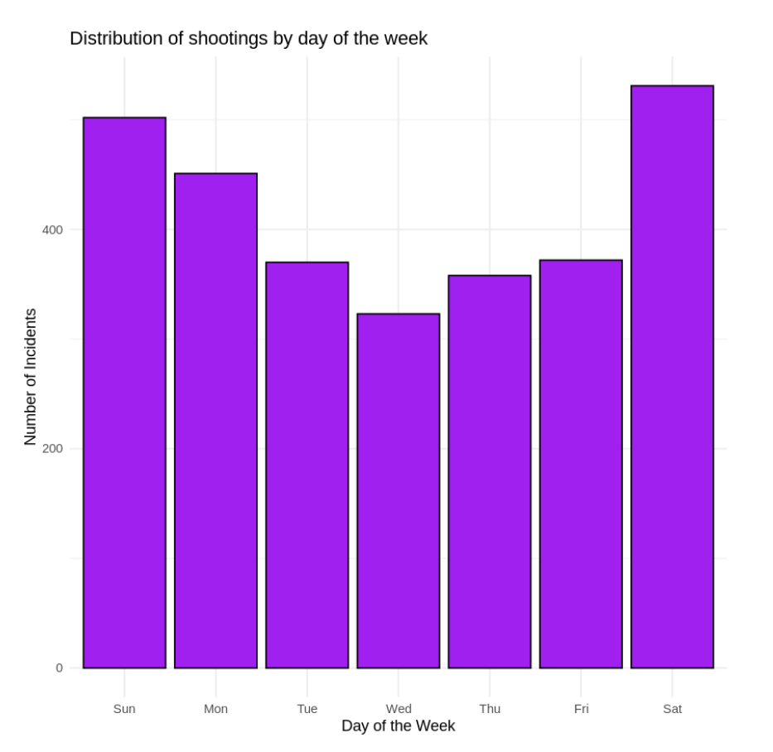
Incident Trends Over Time
Graph: Line graph displaying shooting incidents over time (weeks).

Slide 10
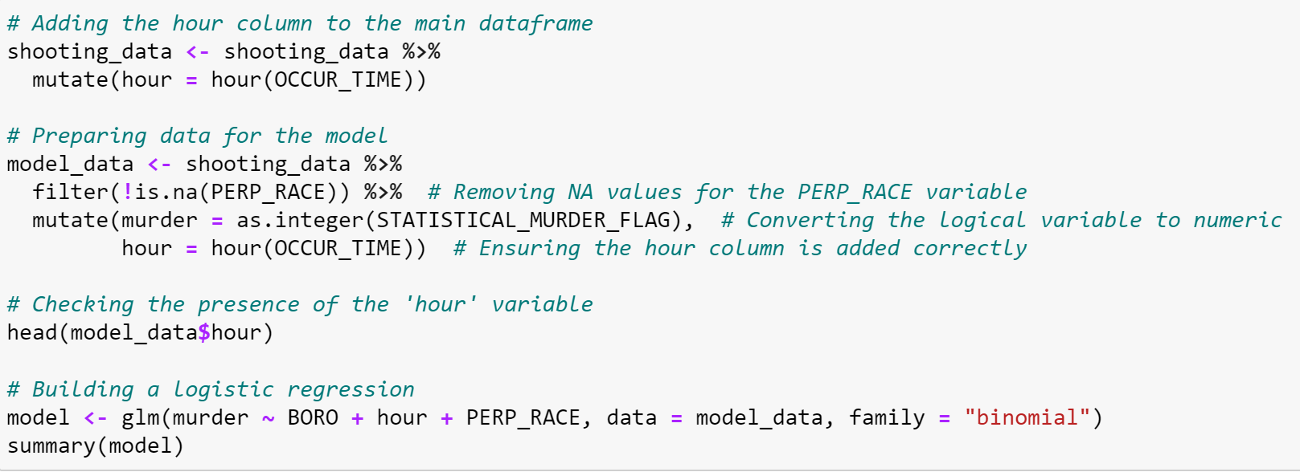
Predictive Analysis Using Logistic Regression
- Model Description: Logistic regression to predict the likelihood of an incident being a homicide.
- Model Summary: The logistic regression model evaluates the influence of borough, hour, and perpetrator race on the likelihood of a shooting being classified as a homicide.

Slide 11
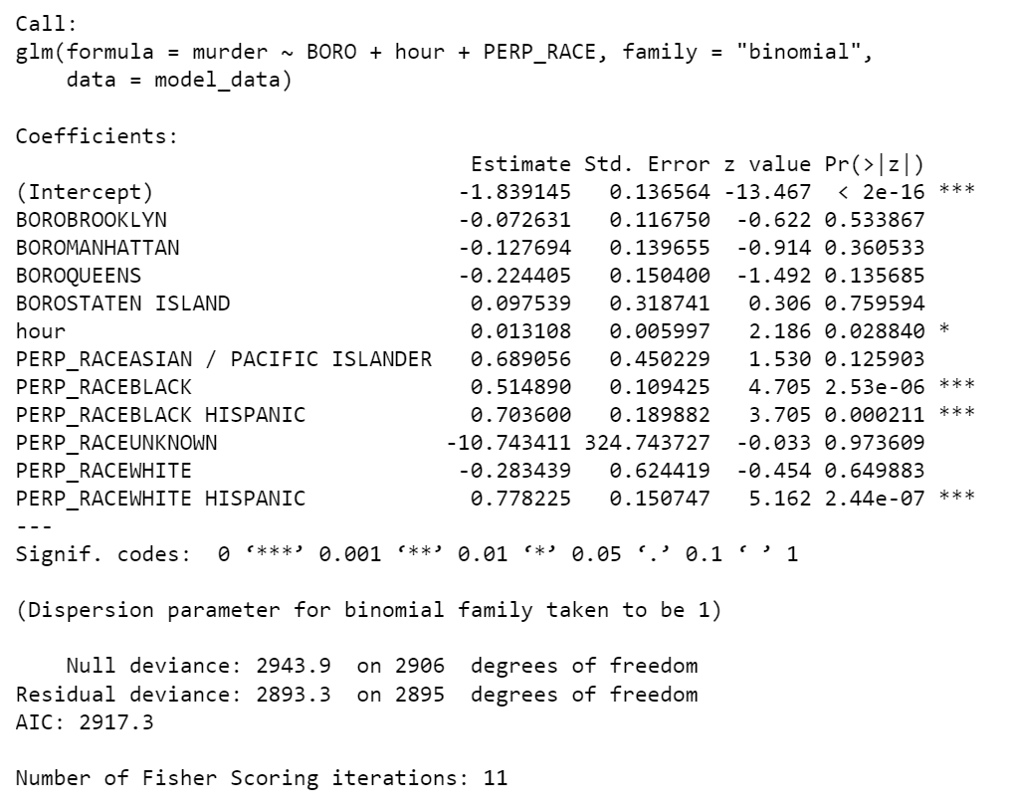
Conclusion (Predictive Analysis Using Logistic Regression)
Key Findings:
- Race as a Predictor: Significant predictors include perpetrator races 'Black' and 'White Hispanic', both of which substantially increase the probability of incidents being homicides.
- Borough Influence: Among boroughs, only 'Staten Island' shows a positive association, although not statistically significant.
- Time Factor: The hour of the incident is also a significant predictor, with incidents later in the day more likely to result in homicide.
Model Effectiveness:
- Goodness of Fit: The model's AIC is 2917.3, and the decrease from null deviance to residual deviance shows the model's utility in explaining the variance in the data.

Slide 12

Data-Driven Insights and Recommendations
Our analysis revealed key patterns and trends in NYC shooting incidents. We recommend targeted interventions in high-risk areas and times, backed by our data-driven insights to optimize resource allocation and enhance public safety.
We critically assessed potential biases in our dataset, including reporting bias and selection bias. Understanding these biases is essential for interpreting our findings accurately and ensuring the reliability of our conclusions.

Slide 13

Potential Biases in the Data
Identifying potential biases in the dataset and analysis is crucial for ensuring the findings' validity and reliability. Here are key sources of bias:
1. Reporting Bias: There may be inconsistencies in incident reporting across different boroughs or precincts. Enhanced community policing and surveillance in certain areas could lead to overrepresentation of incidents.
2. Selection Bias: The dataset may not represent all shooting incidents, potentially excluding unreported cases, which could skew the analysis.

Slide 14

Potential Biases in the Data
3. Measurement Bias: Data entry accuracy, such as incident timing or homicide classification, might be affected by human error or subjective judgments.
4. Geographical Bias: The dataset might overrepresent urban centers while overlooking less populated or rural areas.
5. Temporal Bias: If data collection intensified in recent years, earlier data might be underrepresented, skewing long-term trend analysis.
6. Socioeconomic Bias: Incident reporting might vary by area due to differences in police presence or community engagement.

Slide 15

Thank you for you attention!

